Slide 1
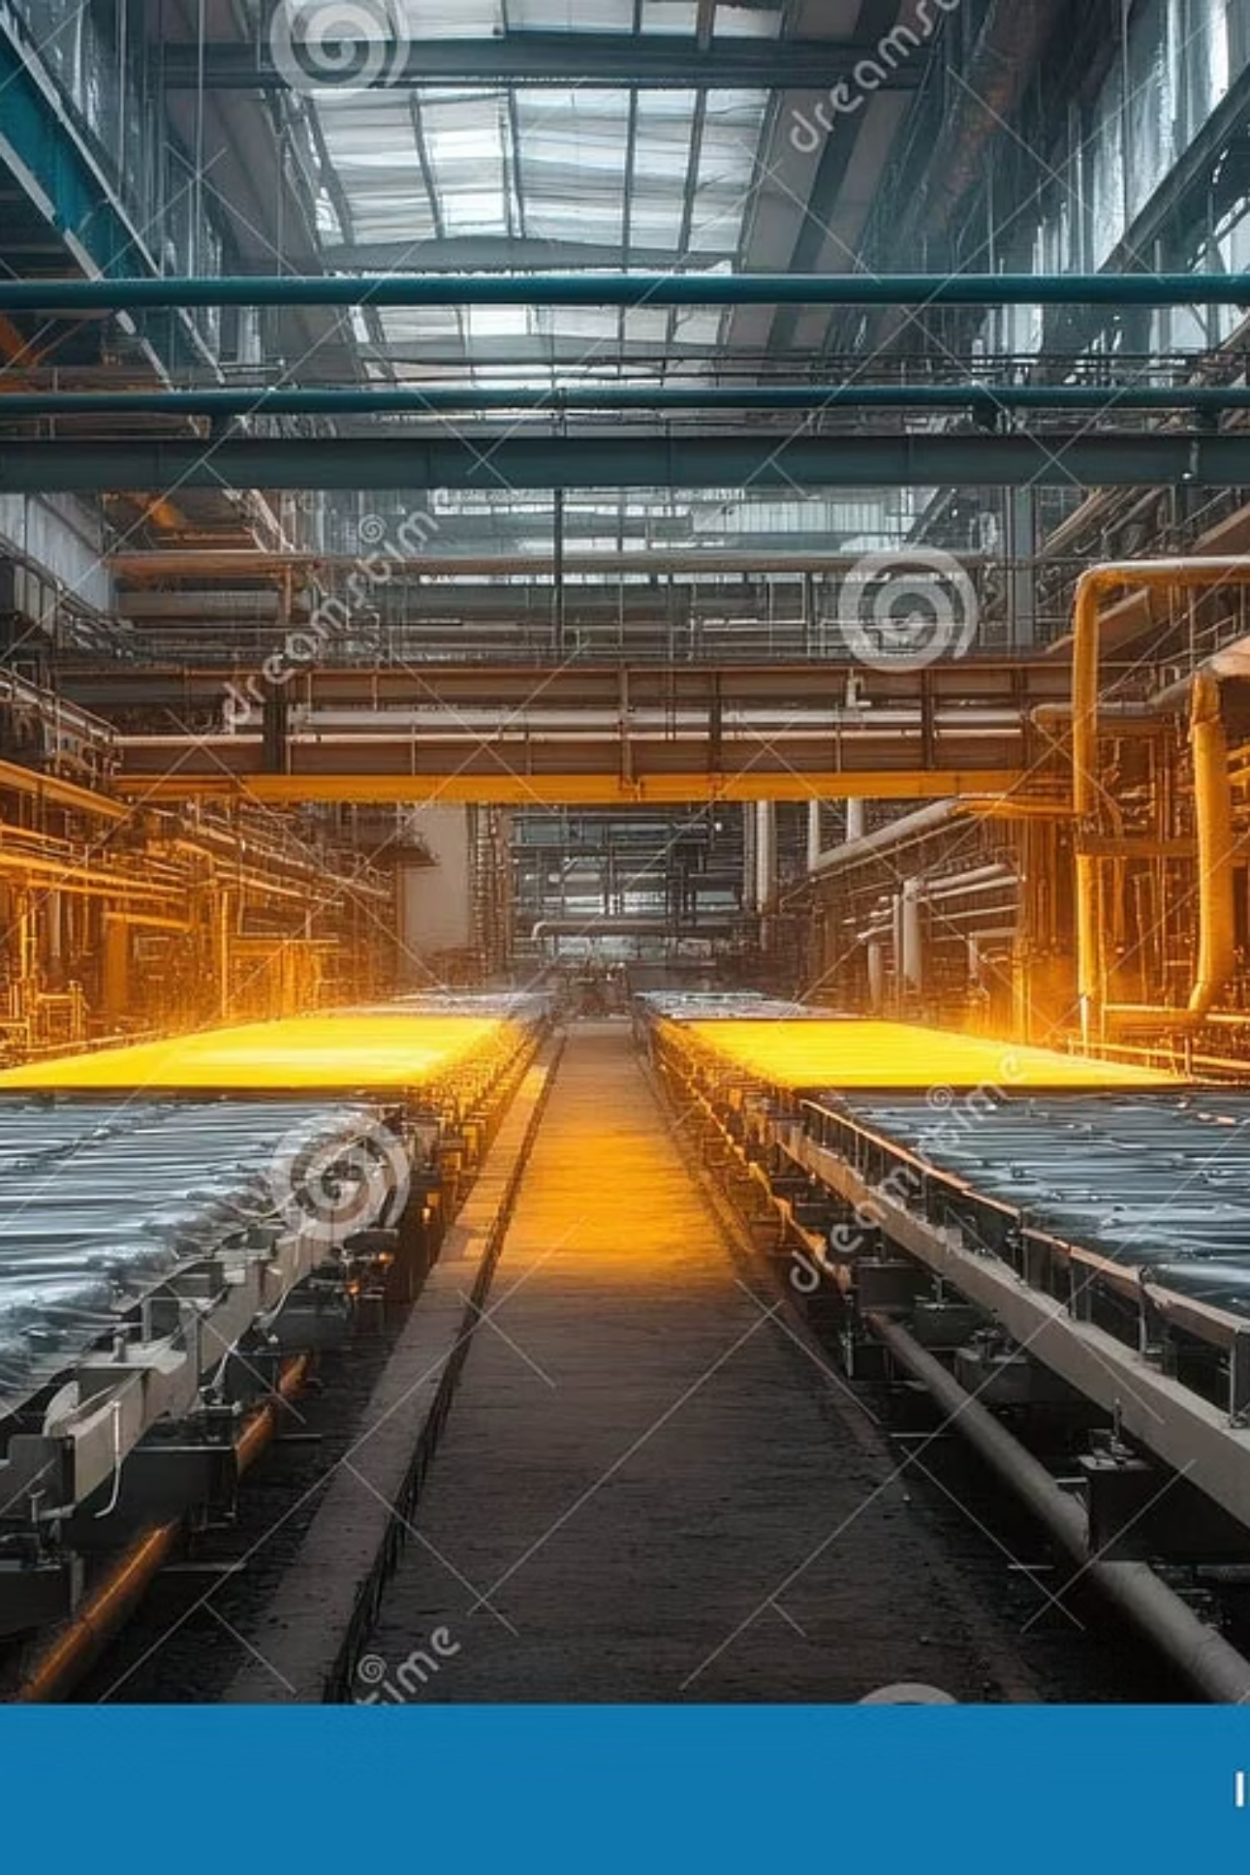
Corporate Briefing Session 2025
Beco Steel Limited
CEO Muhammad Ali Shafique
CFO
Afifa Shafique
Manager Muhammad Imran

Slide 2
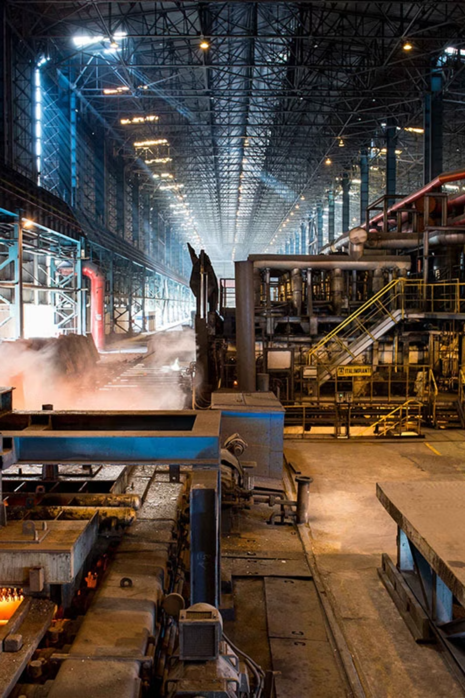
Company Profile and Overview
Beco Steel Limited is a prominent player in the steel industry, focusing on manufacturing and distribution. Established with a commitment to quality and innovation, the company has steadily grown its operations. Our core business is producing a range of steel products for diverse industrial applications.
Over the past few years, Beco Steel has invested significantly in property, plant, and equipment to enhance production capacity and efficiency. The company aims to maintain its competitive edge through strategic investments and operational excellence.

Slide 3




Equity & Liabilities Overview
Total Equity
Increased by 4.50% in 2025 to 3,225,759,928 Rupees.
Total Non-Current Liabilities
Increased by 8.33% in 2025 to 134,221,632 Rupees.
Total Current Liabilities
Increased by 8.50% in 2025 to 4,305,751,279 Rupees.

Slide 4








Debt & Shareholder Ratios: 2023-2025
Interest Coverage Ratio
Total Debt Ratio
Strong improvement to 36.721 in 2025, showing better ability to cover interest payments.
Slight increase to 0.562 in 2025, indicating stable debt levels.
Book Value per Share
Debt/Equity Ratio
Increased in 2025, reflecting higher intrinsic value.
Stable at 0.040 in 2025, indicating controlled leverage.

Slide 5
Profitability Ratios: Measuring Performance
Profitability ratios evaluate the company's ability to generate earnings relative to its revenue, assets, and equity. The return on assets and equity show a positive trend in 2025.
0.015
0.073
0.052
Return on Assets (2025)
Return on Equity (2025)
Gross Profit Ratio (2025)
Positive after two years of negative returns, reflecting improved asset utilization.
Significant improvement, indicating better returns for shareholders.
Increased from (0.005) in 2023, showing better control over direct costs.

Slide 6

Liquidity Ratios: Short-Term Financial Health
Liquidity ratios assess the company's ability to meet its short-term obligations. Beco Steel's current and quick ratios show improvements, indicating better short-term financial health.
0.93
0.39
(0.04)
Current Ratio (2025)
Quick Ratio (2025)
Net Working Capital Ratio (2025)
Improved from 0.76 in 2023, indicating better ability to cover short-term liabilities.
Increased from 0.29 in 2023, showing enhanced liquidity without relying on inventory.
Improved from (0.11) in 2023, though still negative, indicating a need for further optimization.

Slide 7
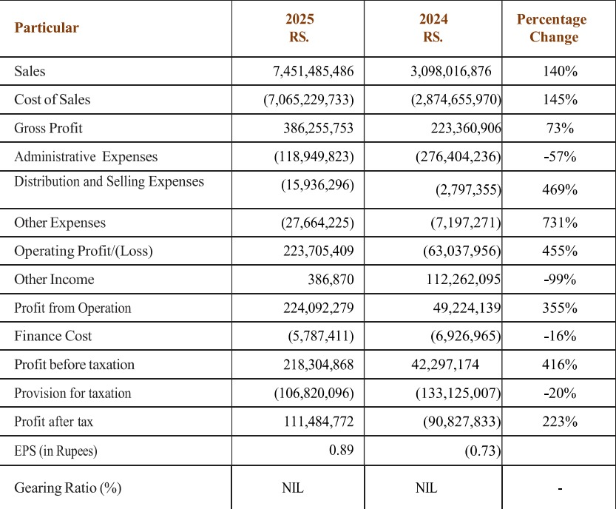
INCOME STATEMENT

Slide 14
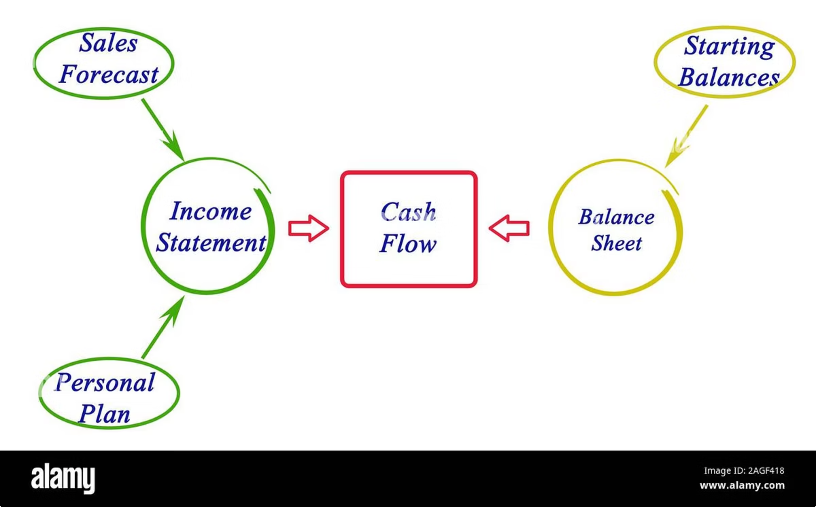
Cash Flow Statement Highlights
Operating Activities
Cash flow increased by 61% in 2025 to 242,412,519 Rupees.
Investing Activities
Outflow decreased by 26% in 2025 to (22,835,140 Rupees).
Financing Activities
Cash flow increased significantly by 876% in 2025 to 24,772,041 Rupees.
Total Change in Cash & Bank
Positive change of 244,349,420 Rupees in 2025.

Slide 15

Our Achievements and Challenges
Beco Steel Limited has achieved significant milestones, including substantial revenue growth and improved profitability in 2025. However, the company also faces ongoing challenges.
Achievements for the Year
Challenges for the Company
Achieved PKR 7.4B in net revenue, a record high.
Volatile raw material prices and energy costs impacting margins.
Returned to profitability with PKR 111M profit after tax.
Intense competition in both domestic and international markets.
Strengthened liquidity with improved current and quick ratios.
Need for continuous technological upgrades to maintain efficiency.
Increased cash flow from operating activities, demonstrating operational efficiency.

Slide 16

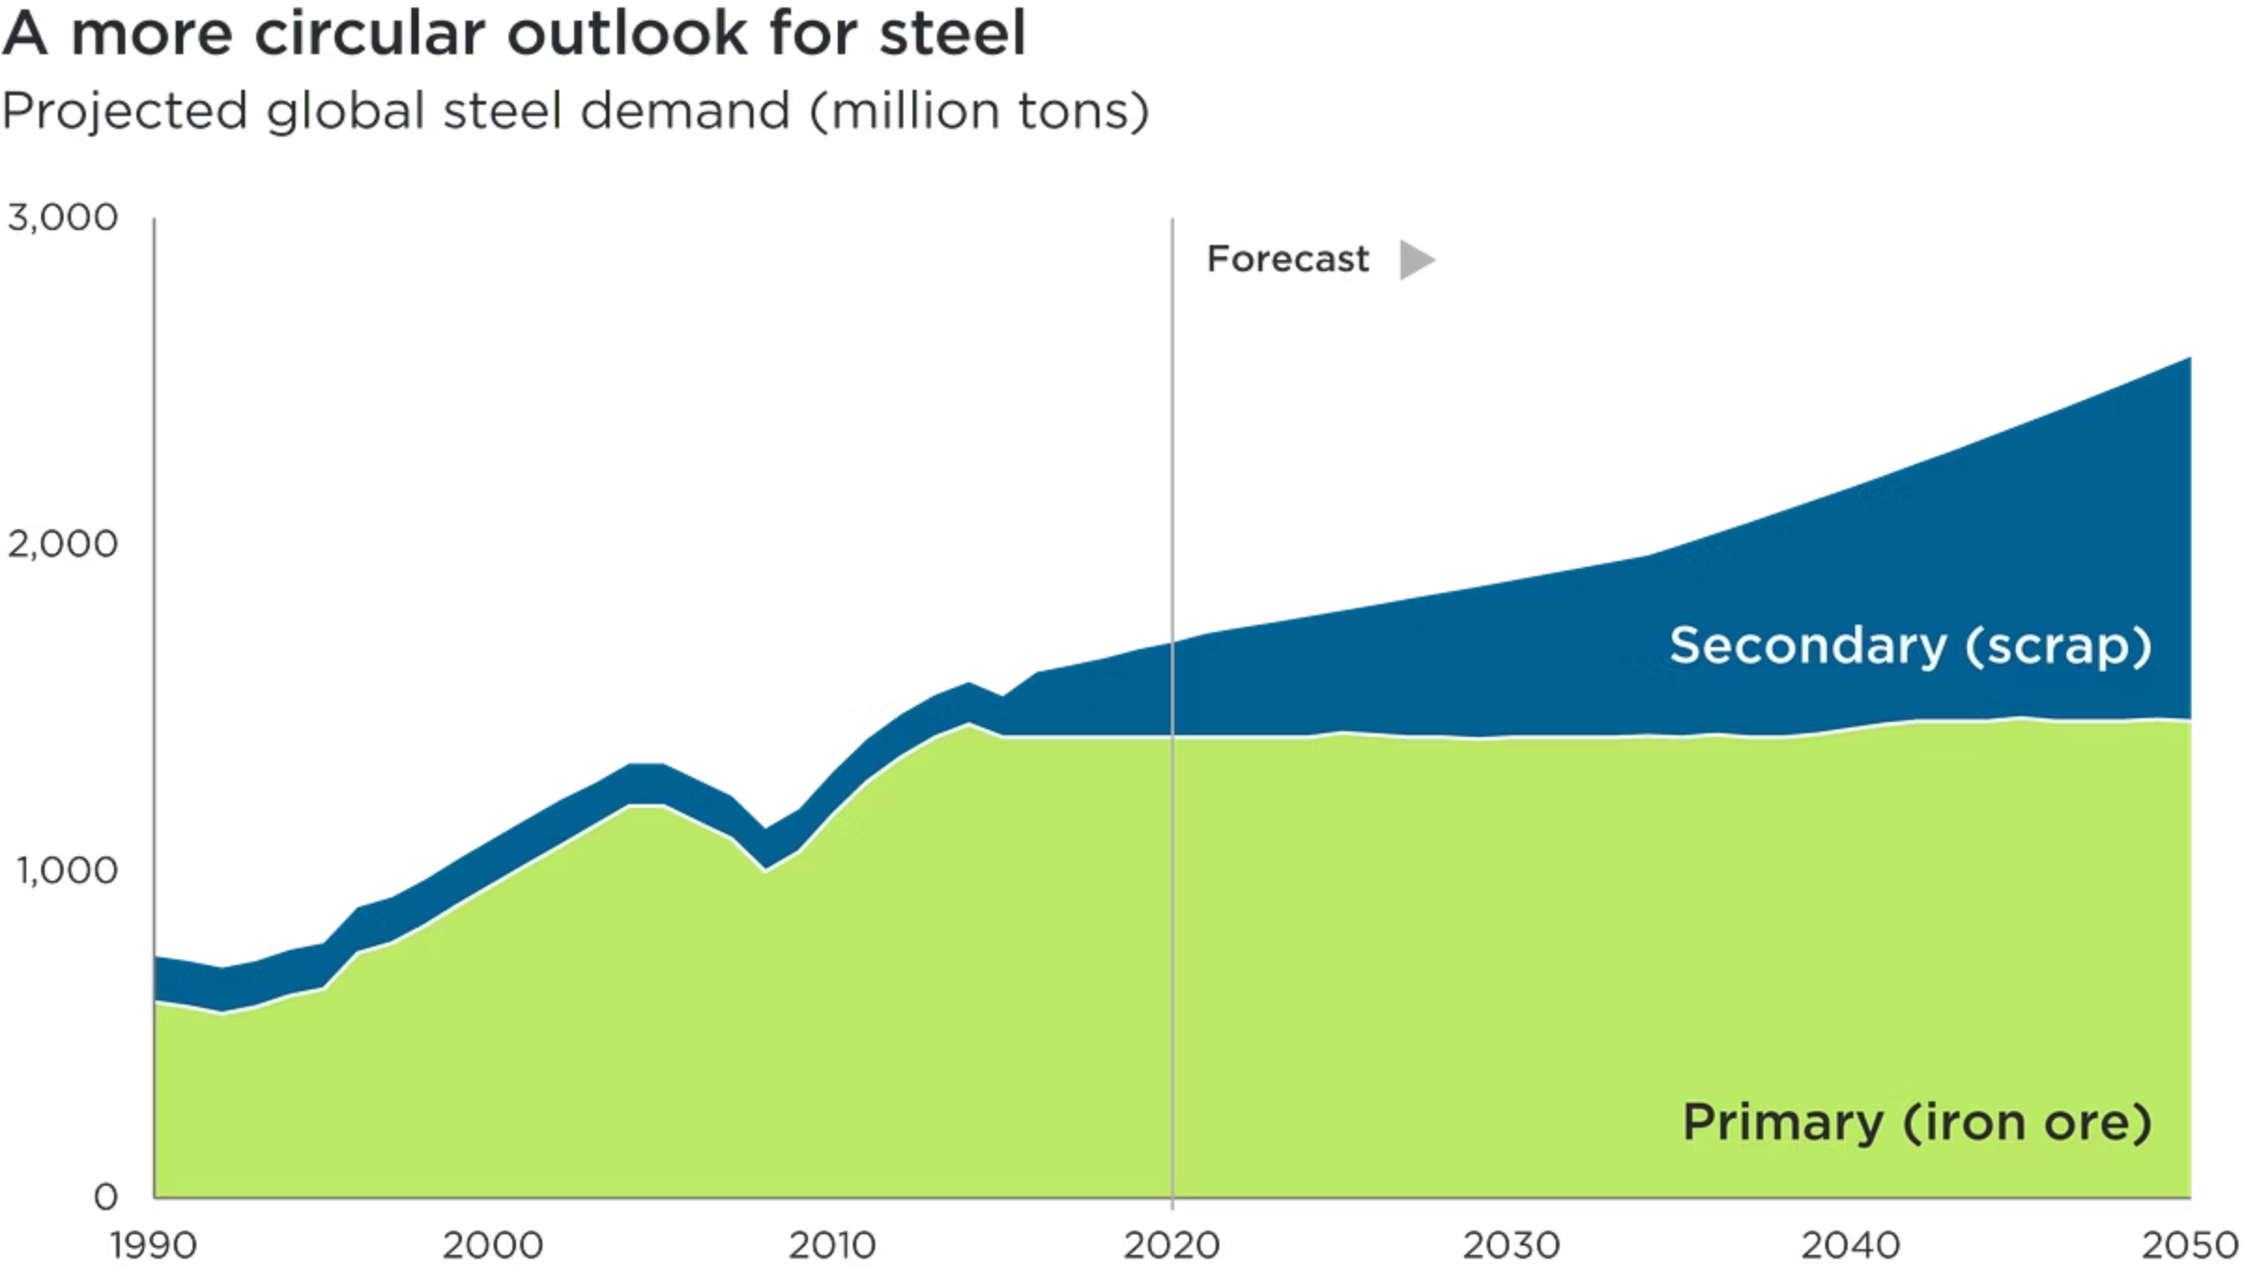
Industrial Analysis: Beco Steel
Cyclical Industry
Influenced by global economy, infrastructure, raw material prices.
Coal to Green Energy
Transitioning from traditional coal to sustainable green energy sources.

Slide 17
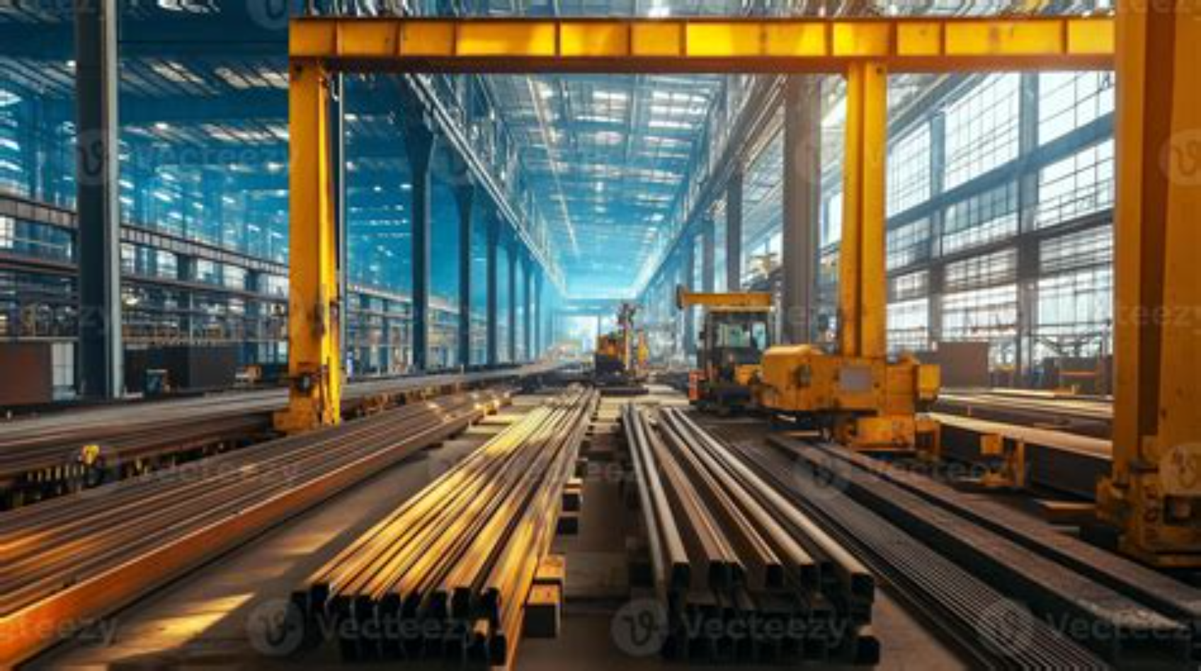

Future Outlook & Market Trends

Slide 18
THANK
YOU!

